Slide 1
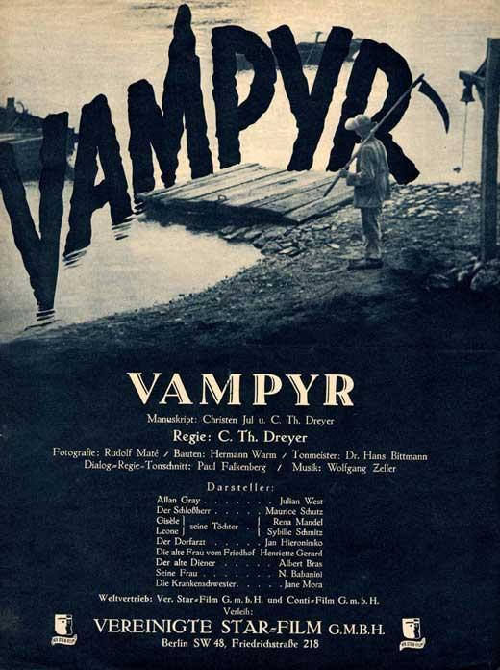
Vampyr Carl Theodor Dreyer 1932

Slide 2
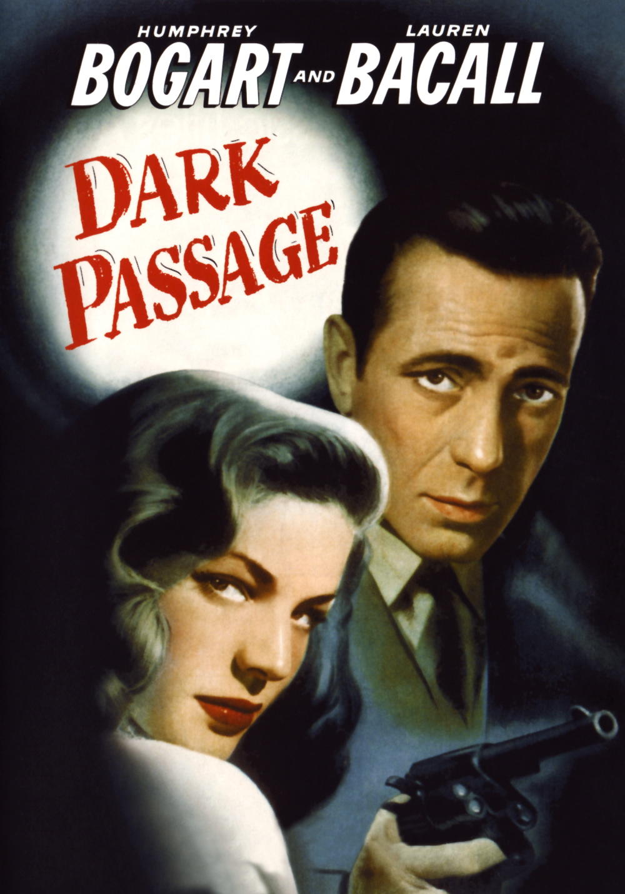
Dark Passage Delmer Daves 1947

Slide 3
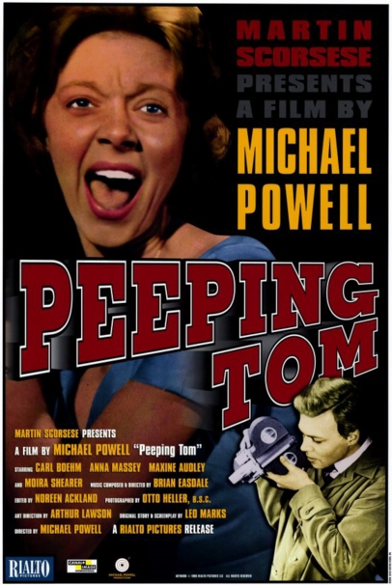
Peeping Tom Michael Powell 1960

Slide 4
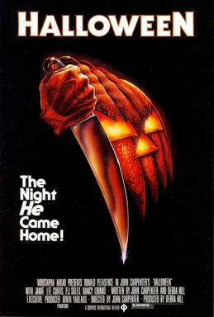
Halloween John Carpenter 1978

Slide 5
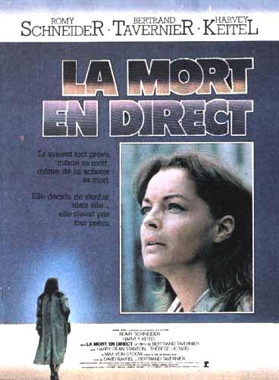
La mort en direct Bertrand Tavernier 1980

Slide 6
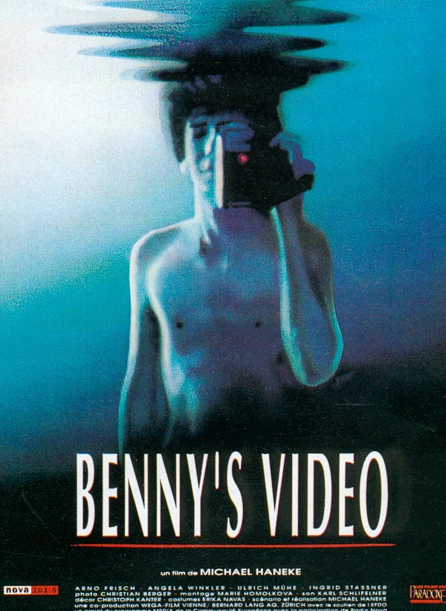
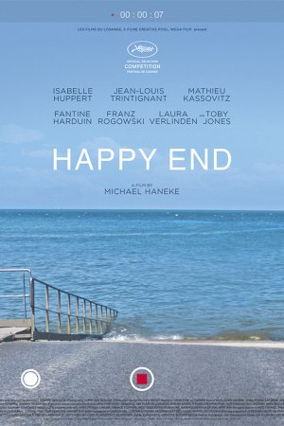
Michael Haneke

Slide 7
Code Inconnu Michael Haneke 2000

Slide 8
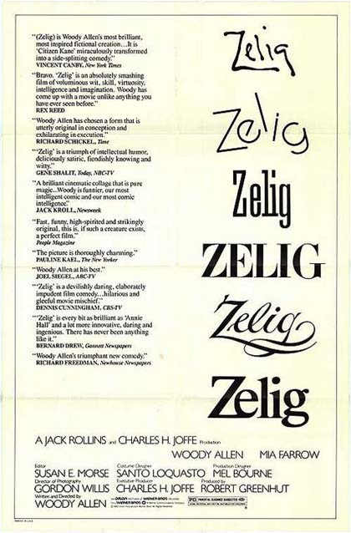
Zelig Woody Allen 1983

Slide 9
The War Game Peter Watkins 1965

Slide 10
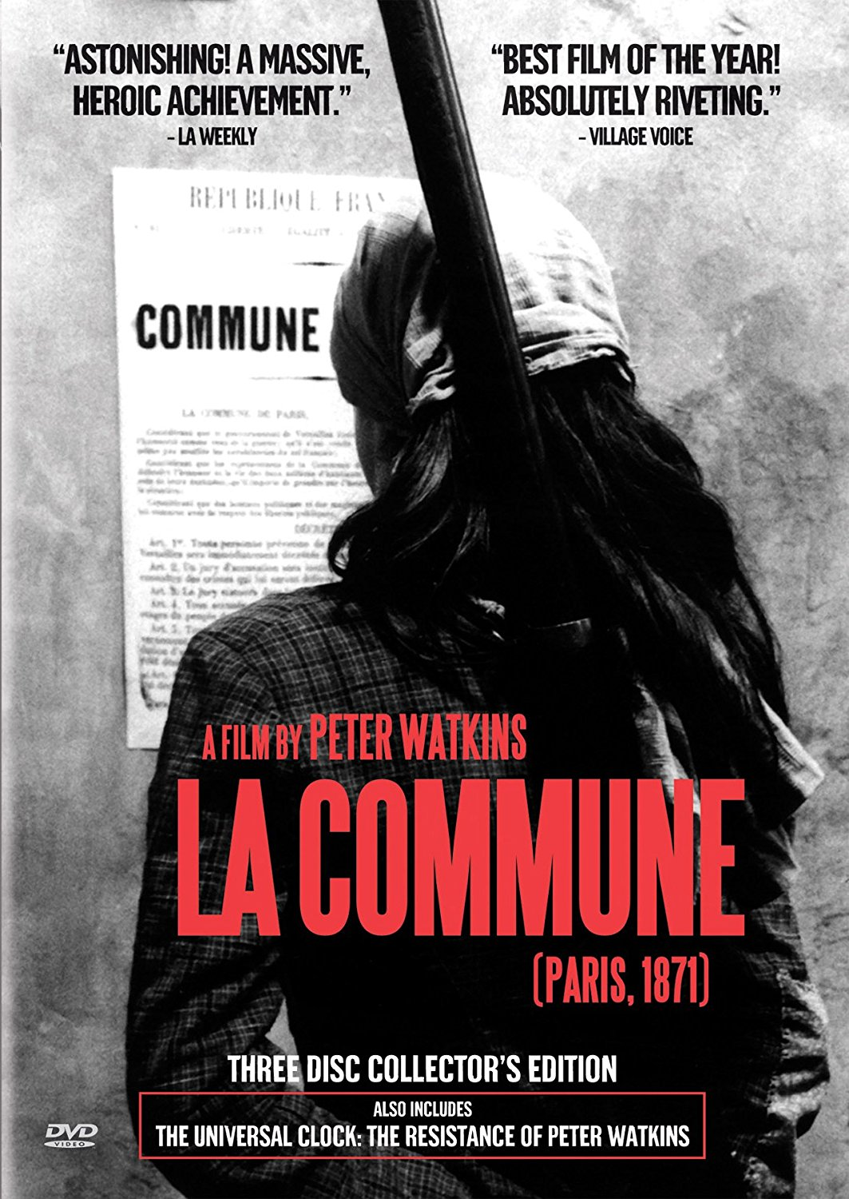
La Commune (Paris 1871) Peter Watkins 2000

Slide 11
Cannibal Holocaust Ruggero Deodato 1980

Slide 12
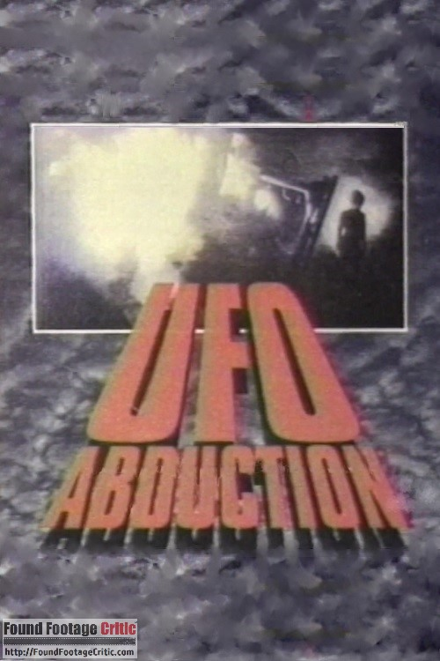
Ufo Abduction The McPherson Tapes Dean Alioto 1989
Alien Abduction
Incident at Lake County Dean Alioto 1997

Slide 13
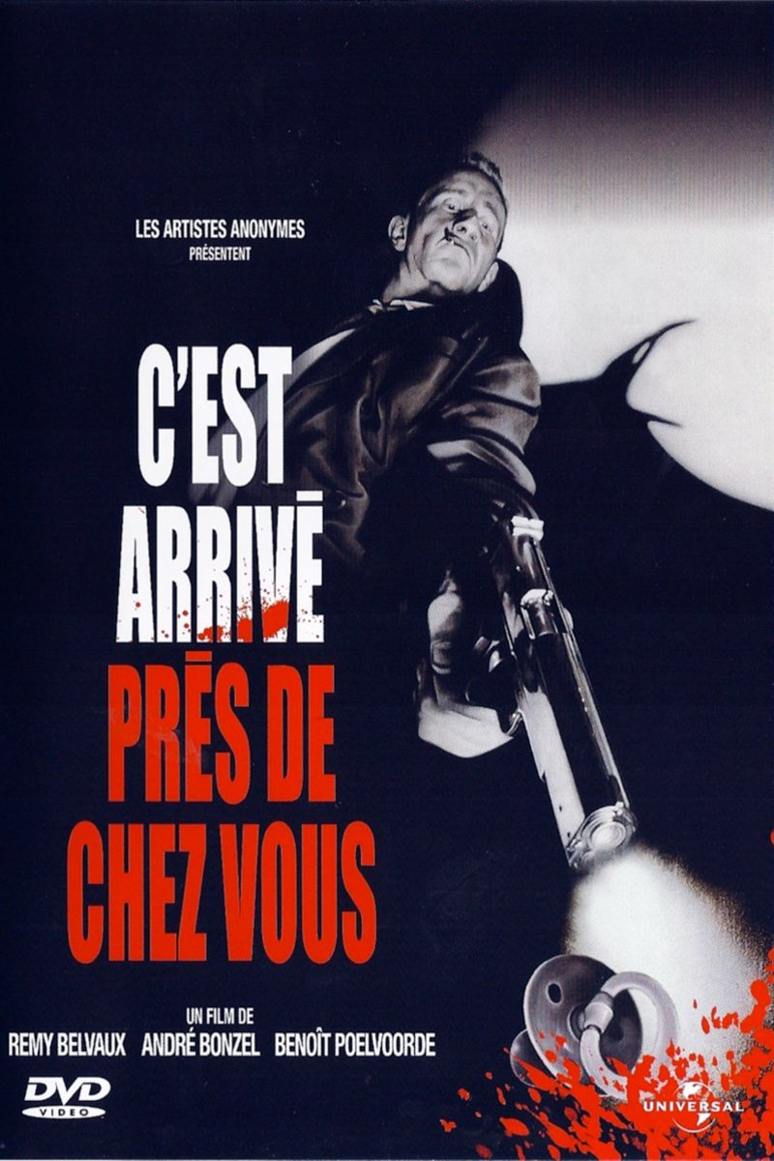
C’est arrivé près de chez vous Remy Belvaux, André Bonzel, Benoit Poelvoorde 1992

Slide 14
Ghostwatch Lesley Manning 1992

Slide 15
The Blair Witch Project Eduardo Sanchez, Daniel Myrick 1999

Slide 16
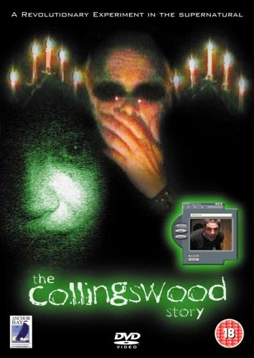
The Collingswood Story Michael Costanza 2002

Slide 17
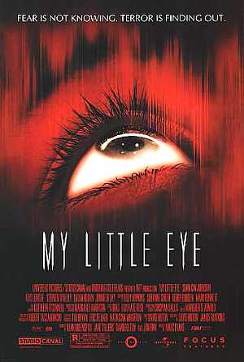
My Little Eye Marc Evans 2002

Slide 18
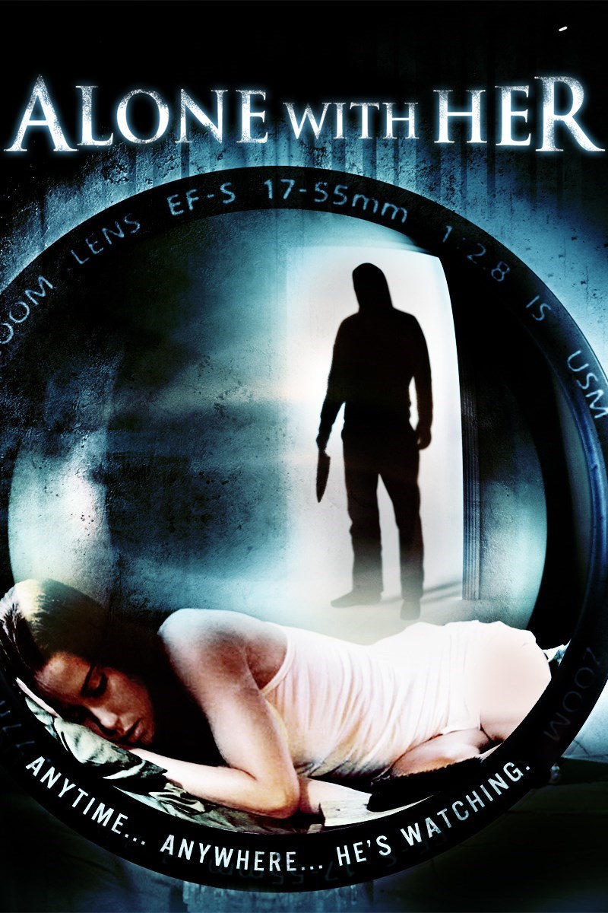
Alone With Her Eric Nicholas 2006

Slide 19
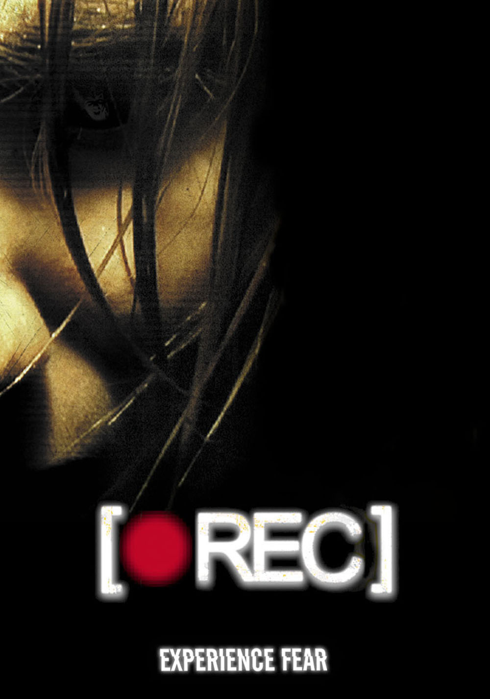
[REC] Jaume Balaguerò, Paco Plaza 2007

Slide 20
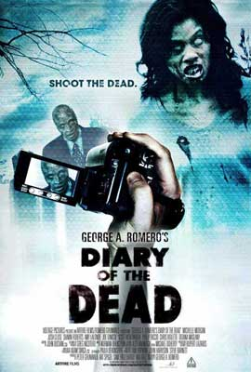
Diary of the Dead George A. Romero 2007

Slide 21
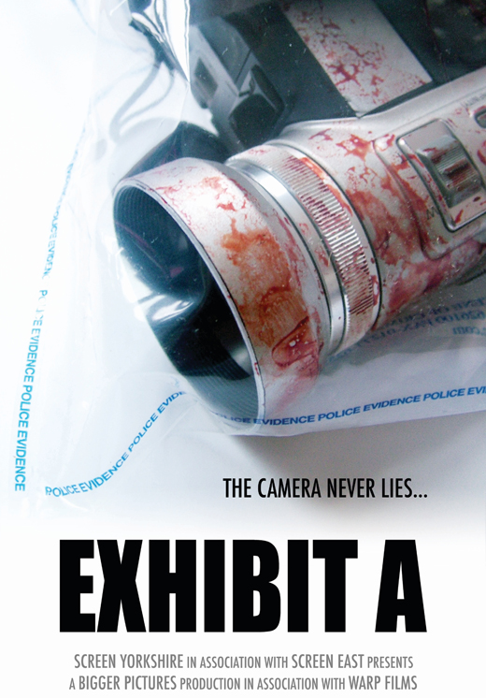
Exhibit A Dom Rotheroe 2007

Slide 22
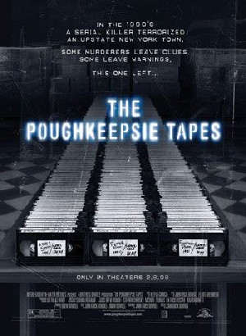
The Poughkeepsie Tapes John Erick Dowdle 2007

Slide 23
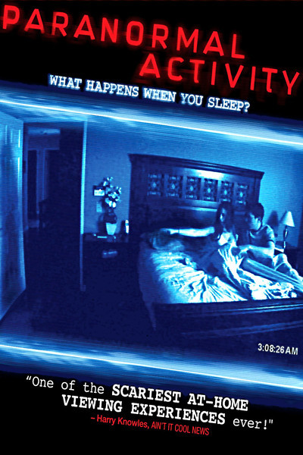
Paranormal Activity Oren Peli 2007

Slide 24
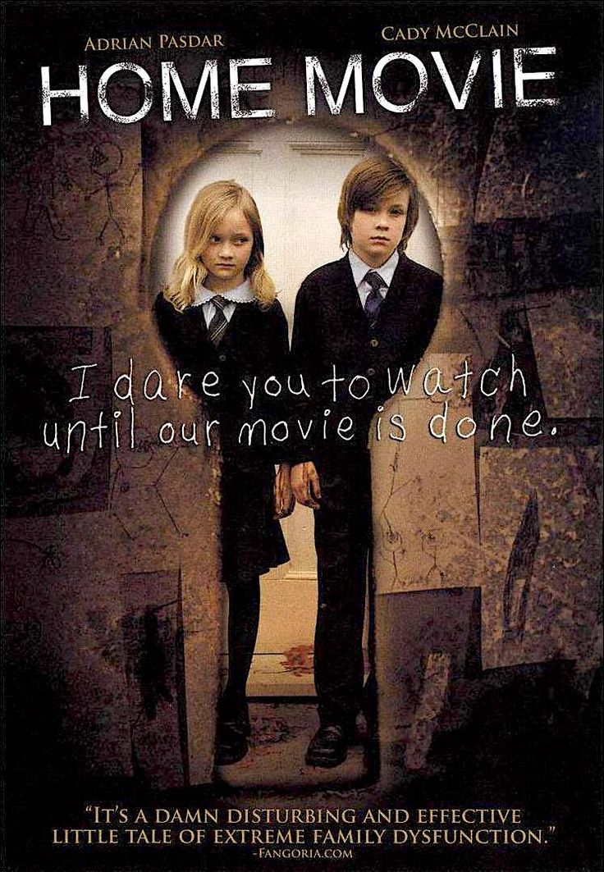
Home Movie Christopher Denham 2008

Slide 25
Lake Mungo Joel Anderson 2008

Slide 26
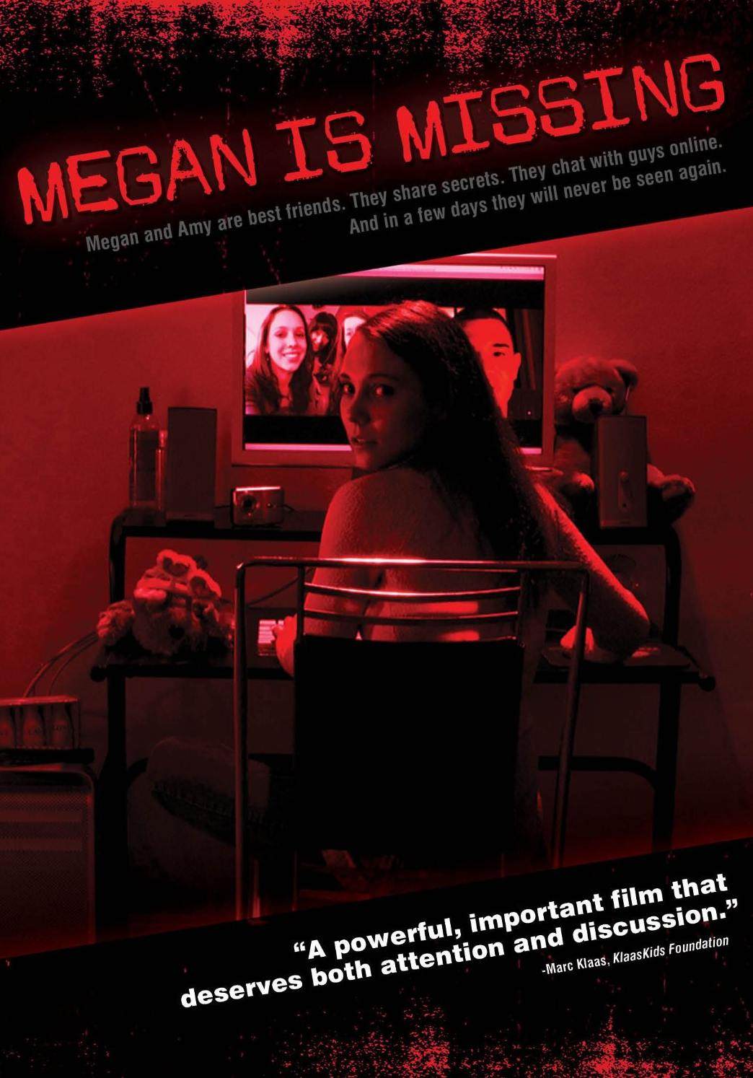
Megan is Missing Michael Goi 2011

Slide 27
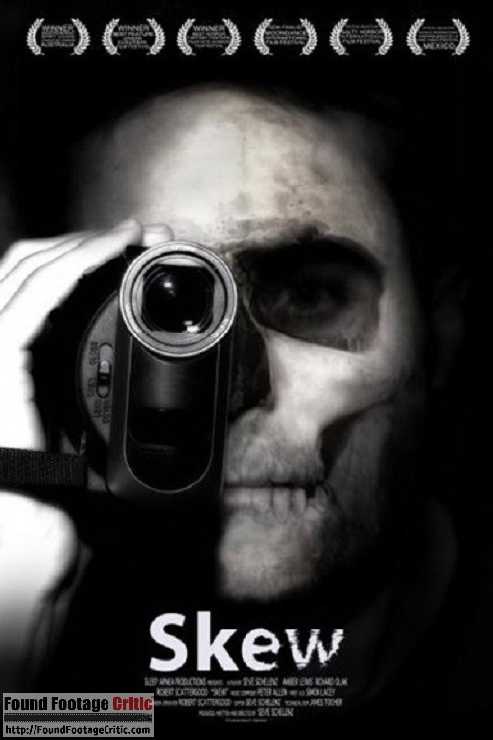
Skew Sevé Schelenz 2011

Slide 28
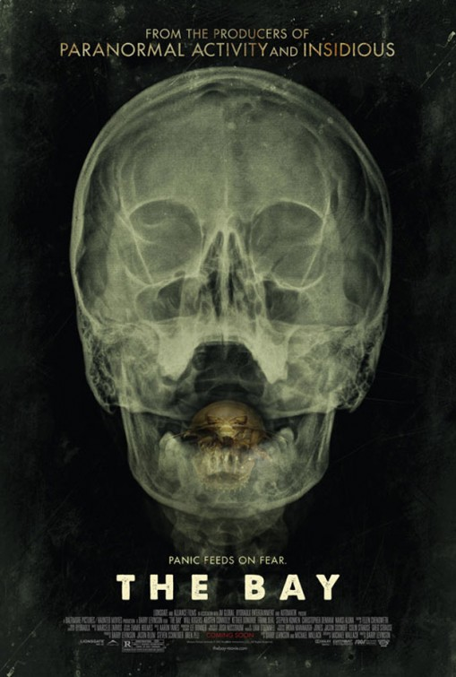
The Bay Barry Levinson 2011

Slide 29
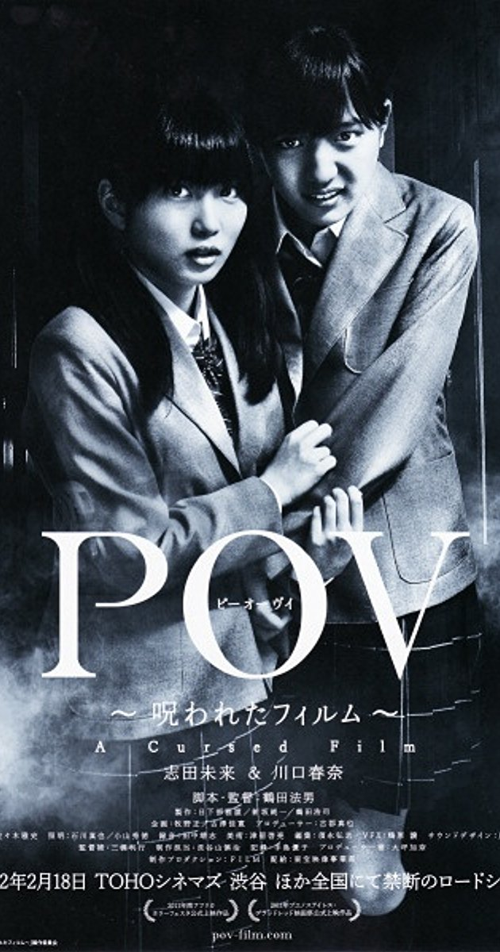
POV – A Cursed Film Norio Tsuruta 2012

Slide 30
V/H/S Trilogy 2012-2013-2014

Slide 31
The Borderlands Elliot Gouldner 2013

Slide 32
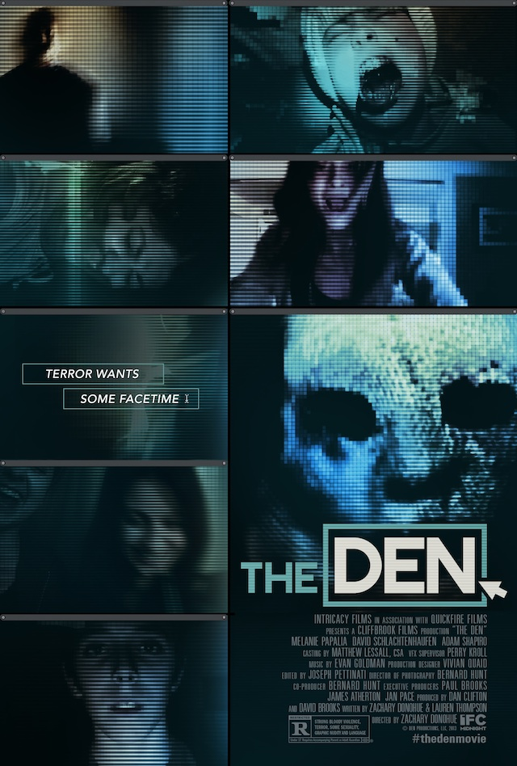
The Den Zachary Donahue 2013

Slide 33
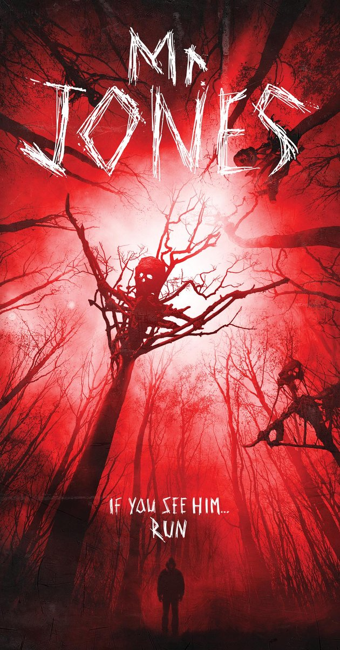
Mr. Jones Karl Mueller 2013

Slide 34
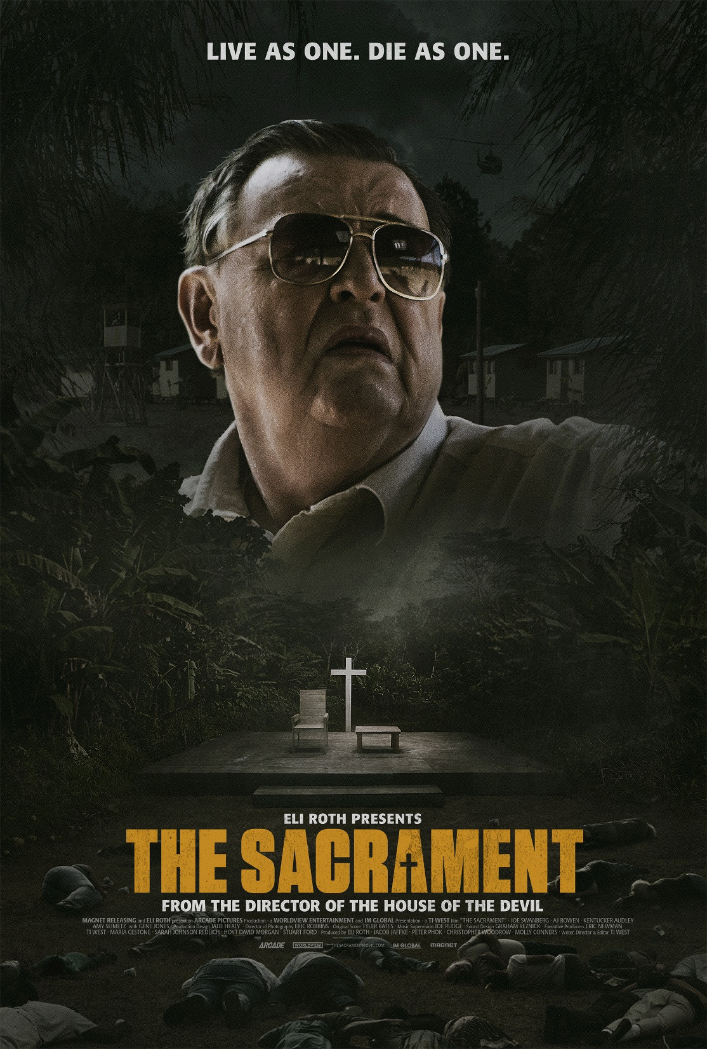
The Sacrament Ti West 2013

Slide 35
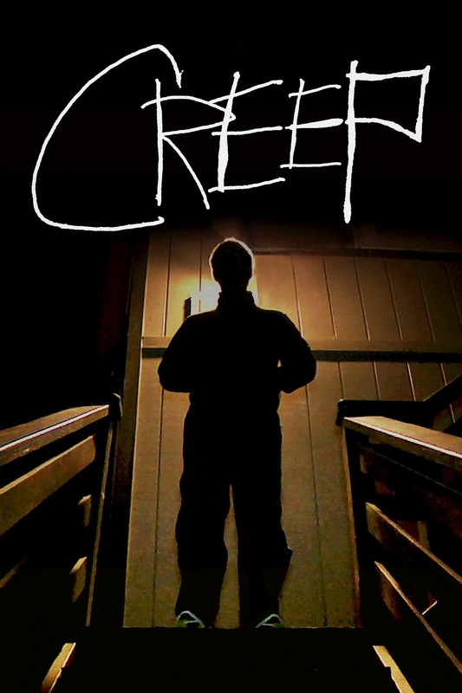
Creep Patrick Brice 2014

Slide 36
Mockingbird Bryan Bertino 2014

Slide 37
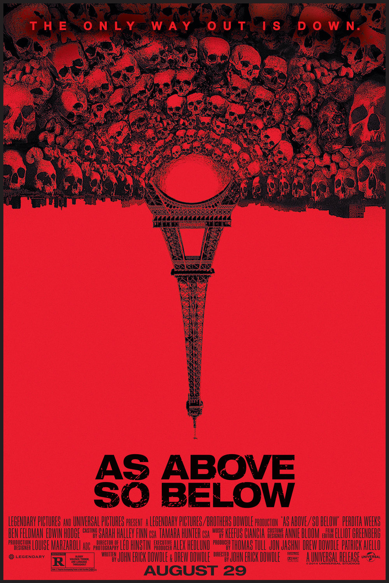
As Above So Below John Erick Dowdle 2014

Slide 38
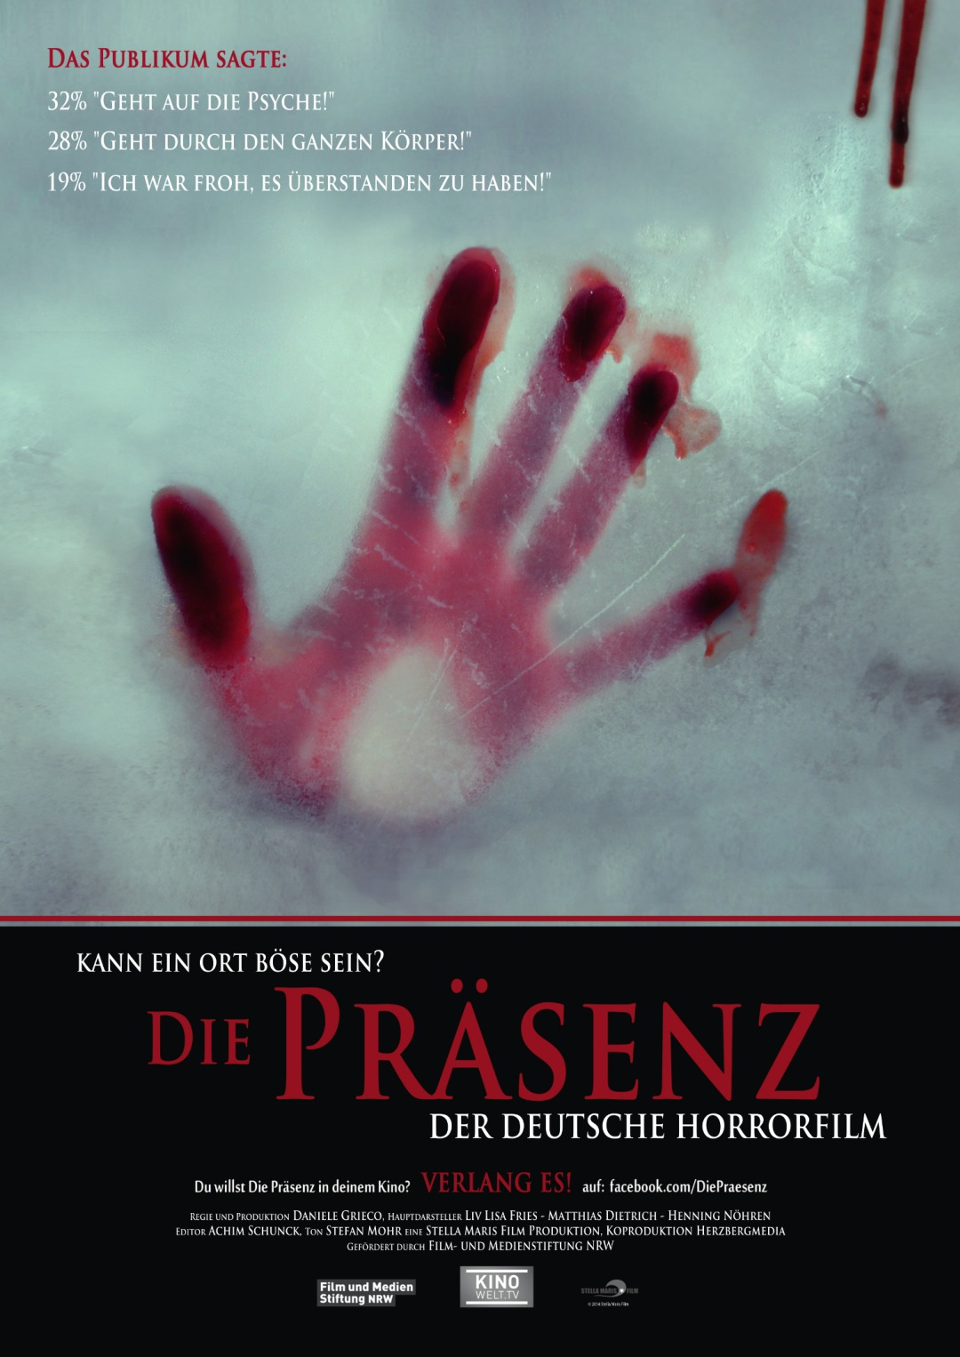
Die Präsenz Daniele Grieco 2014

Slide 39
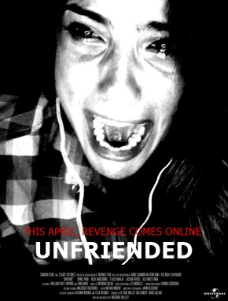
Unfriended Levan Gabriadze 2014

Slide 40
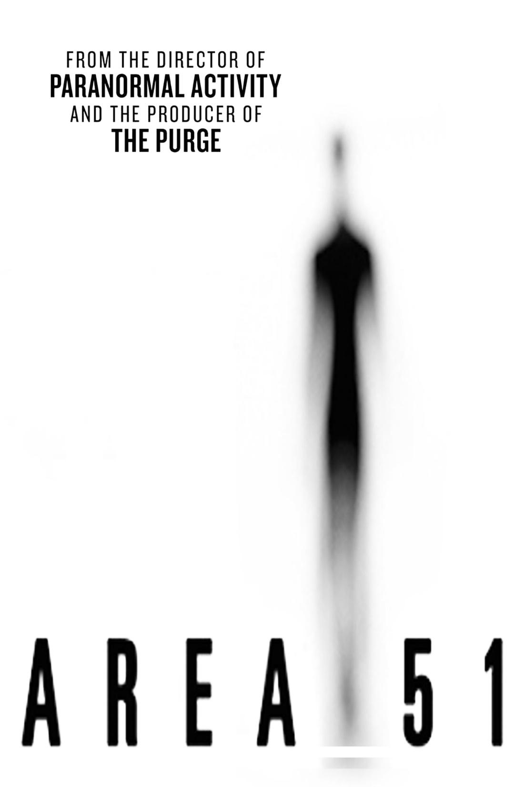
Area 51 Oren Peli 2015

Slide 41
Be My Cat A Film for Anne Adrian Tofei 2015

Slide 42
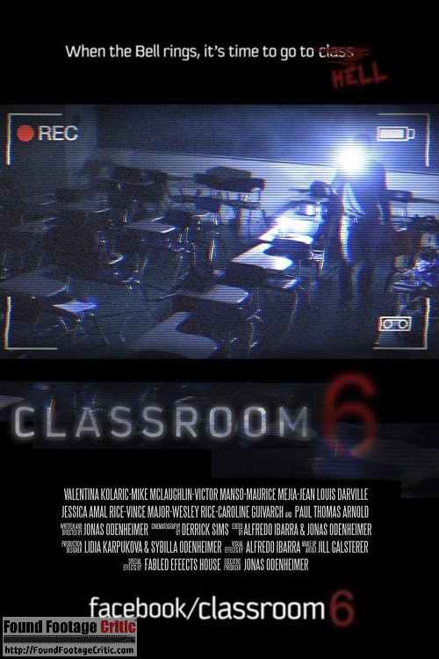
Classroom 6 Joshua Odenheimer 2015

Slide 43
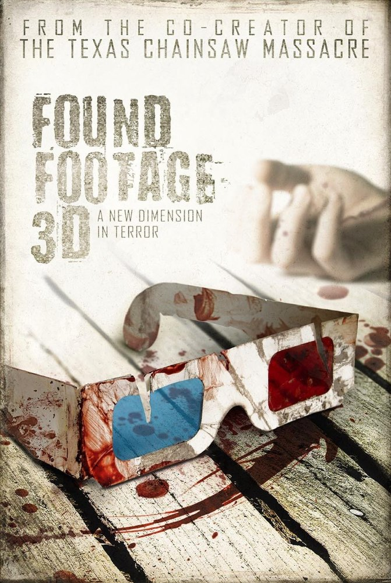
Found Footage 3D Stephen DeGennaro 2015

Slide 44
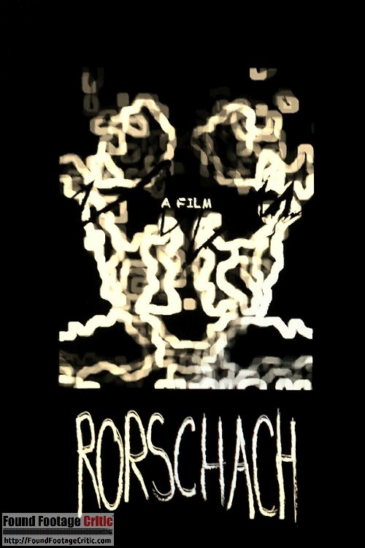
Rorschach C.A. Smith 2015

Slide 45
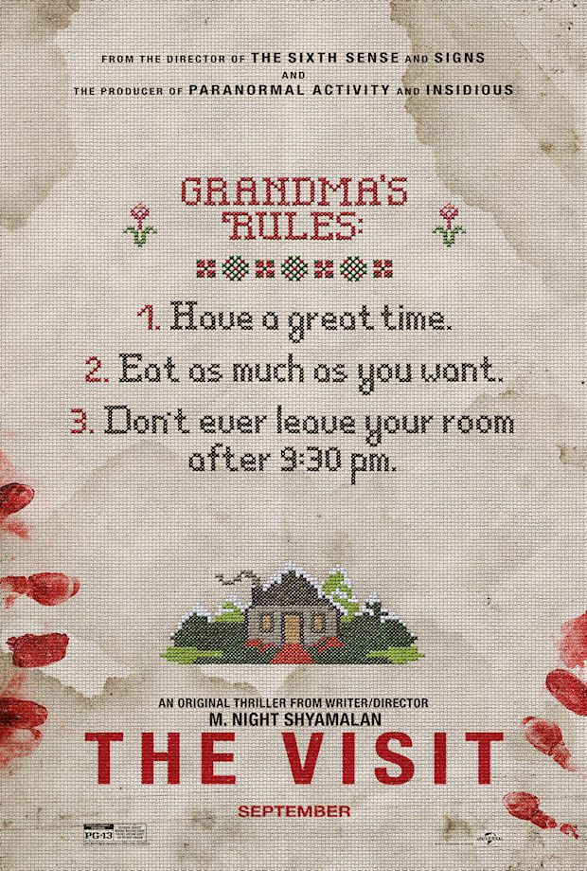
The Visit M. Night Shyamalan 2015

Slide 46
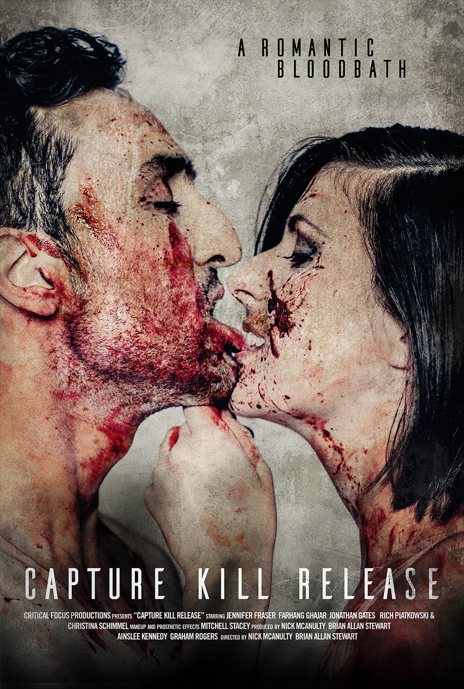
Capture Kill Release Nick McAnulty, Brian Allan Stewart 2016

Slide 47
Sickhouse Hannah MacPherson 2016

Slide 48
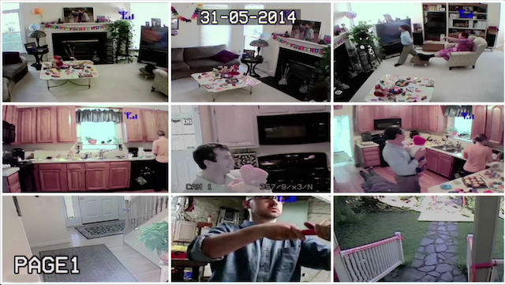
This House Has People In It Alan Resnick, Dina Kelberman, Robby Rackleff 2016

Slide 49
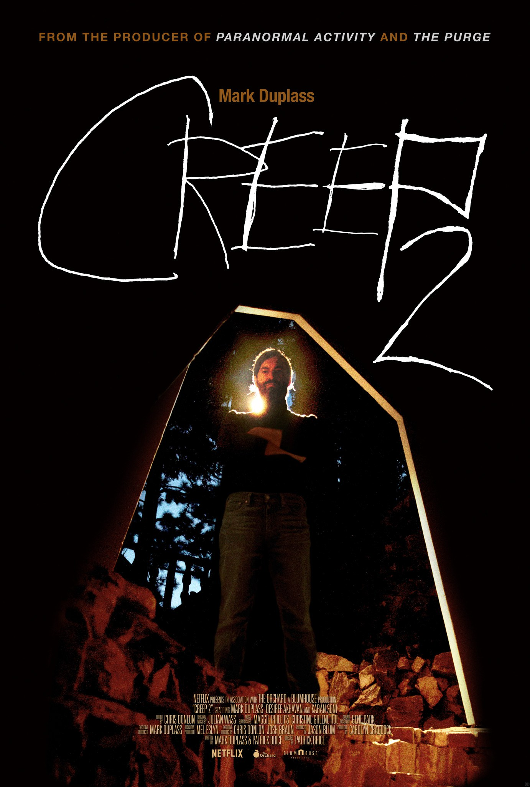
Creep 2 Patrick Brice 2017

